Slide 1


DETECTION OF COVID-19 VIRUS
USING MACHINE LEARNING
Submitted To:
Mr. Sanjay Madan
Submitted by:
Arpit shrivastav Rohan Abbhi Ritesh Kumar
CENTER FOR DEVELOPMENT OF ADVANCED COMPUTING,MOHALI

Slide 2
CONTENT
Introduction
Workflow
Project Objective
Dataset Description
Technologies
Libraries Used
Data Cleaning
Data Visualization
Building the model
Evaluation
Conclusion

Slide 3
INTRODUCTION
Coronavirus disease 2019 (COVID-19) is a contagious disease caused by a virus, the severe acute respiratory syndrome coronavirus 2 (SARS-Cov-2).
The ﬁrst known case was identiﬁed in Wuhan, China, in December 2019. The disease spread worldwide, leading to the COVID-19 pandemic.
Symptoms of COVID-19 are variable, but often include fever,cough,headache,fatigue,breathing difﬁculties,loss of smell,and loss of taste.

Slide 4
PROJECT OBJECTIVE
The Aim of the project is to detect the covid-19 patients on the basis of symptoms.
To detect whether the patient is Covid positive or not.
The goal of this study is the evaluation of different patients with a focus on symptoms and pre-existing illness at admission, this is important for initial assessment and adequate emergency care.

Slide 5
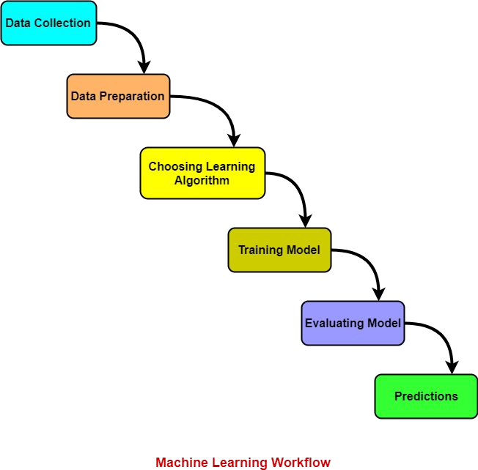
WORKFLOW

Slide 6
DATASET DESCRIPTION
We have taken the Dataset from Kaggle that is in the form of CSV format.
Dataset contains 5434 rows and 21 columns .
There is no missing values for the provided input dataset.
Covid-19 is the variable which notifies whether a particular patient is covid positive or not. And we will be developing our models to detect.

Slide 7
TECHNOLOGIES
Libraries Used :
Numpy
Pandas
Seaborn
Matplotlib
Sklearn

Slide 8
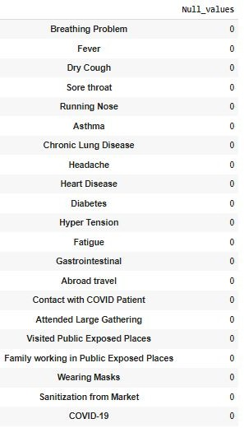
DATA CLEANING
Checking the information about our dataset.
Checking the shape of our dataset.
Checking the null values in the dataset.

Slide 9
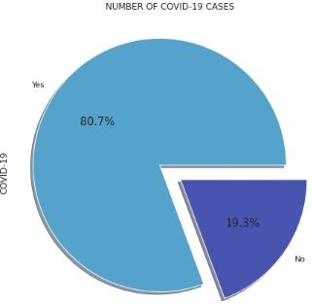
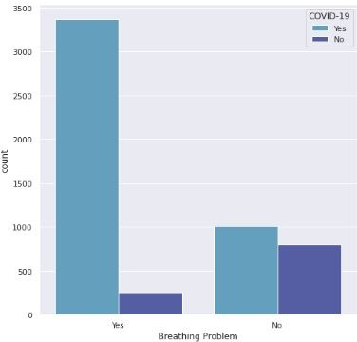
DATA VISUALIZATION
Visualizing covid positive and covid negative patients using pie chart.
Visualizing covid patients who are suffering from breathing problem using countplot.

Slide 10
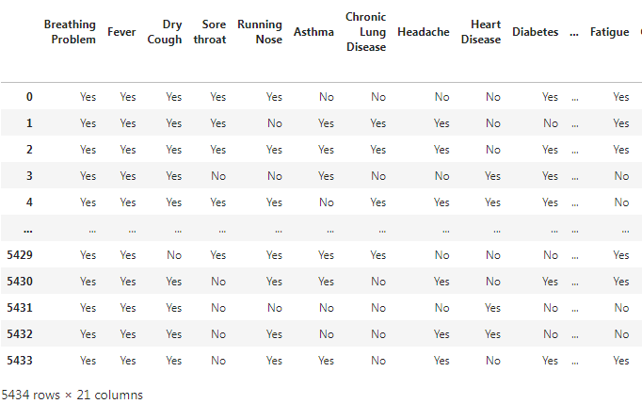
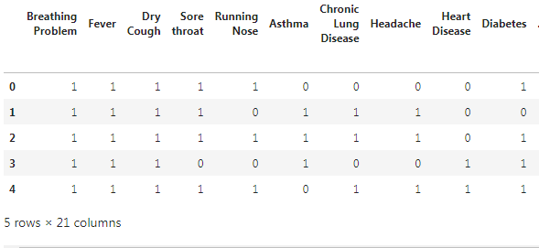
FEATURE TRANSFORMATION
Our data is in categorical format(yes/no) so we converted it into numeric binary format(1/0).
Here, we are using label encoder for feature transformation.
Before Transformation
After Transformation

Slide 11
FEATURE SELECTION
In our dataset ,we have 20 features and 1 target feature(COVID-19).
We found out correlation between features and target feature.
We drop those features which has weak correlation with covid 19(target feature).
Now we have 10 features left which have high correlation with covid 19(target feature).

Slide 12
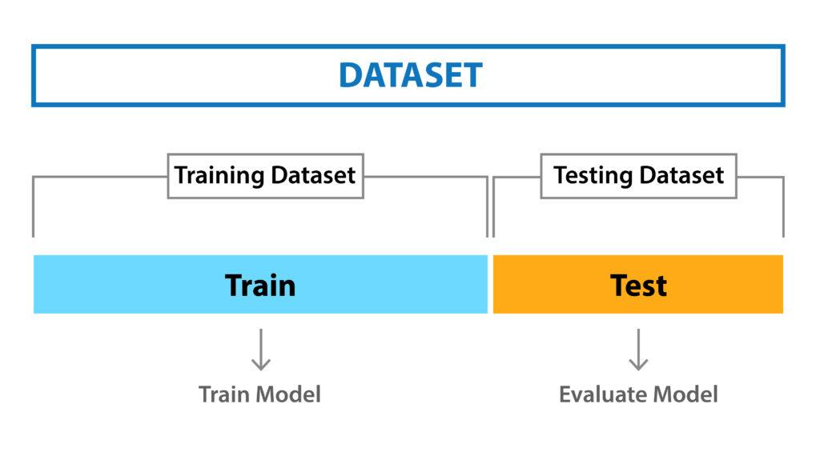
DATASET SPLITTING
Splitting data: We must separate our data into target feature(y) and predicting feature(x).
Train-Test split: we split – training set and testing set in
70:30 ratio.

Slide 13
BUILD MODEL
We know that this is a classification problem as we have to classify patients as covid positive or negative.
First we created a baseline model with logistic regression algorithm then predicted with other ML models like Random Forest regressor, Decision tree classifier, K-neighbors classifier,SVM.
We observed that decision tree model gave the best accuracy among all the models we applied .

Slide 14
Why Decision tree ?
A decision tree model will predict whether the patient belong to one group(covid +ve) or another(covid -ve).
Decision Trees usually mimic human thinking ability while making a decision,so it is easy to understand.
The logic behind the decision tree can be easily understood because it shows a tree-like structure.

Slide 15
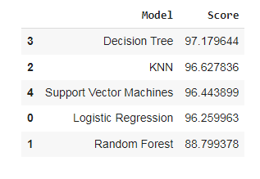
COMPARISON TABLE
After baseline model(Logistic regression), we compare with other ml models for better accuracy score.
We observed that decision tree model gave best accuracy among all models.
We choose decision tree model for prediction.

Slide 16
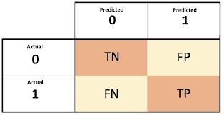

EVALUATION USING CONFUSION MATRIX
Confusion matrix is a visual representation which tells us the degree of four important classification metrics:
True Positive(TP): The number of observation where the model predicted the patient would be covid +ve(1), and they are actually covid +ve(1).
True Negative(TN): The number of observation where the model predicted the patient would be covid -ve(0), and they are actually covid -ve(0).
False Positive(FP):The number of observation where the model predicted the patient would be covid +ve(1), but they are actually covid -ve(0).
False Negative(FN):The number of observation where the model predicted the patient would be covid -ve(0), but they are actually covid +ve(1).

Slide 17
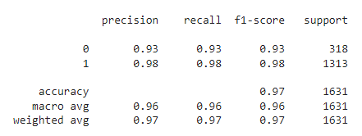
CLASSIFICATION REPORT
Precision: The precision reflects how reliable the model is in classifying samples as positive.
Recall: It measures the model ability to detect +ve samples. The higher the recall, the more +ve samples detected.
Accuracy: Measures the total number of predictions a model gets right, including both true positive and true negatives.
F1 score: Harmonic mean of precision and recall.

Slide 18
CONCLUSION
The conclusion of our project is to detect whether the person has covid positive or not on the basis of severe symptoms.

Slide 19
THANK YOU

